Slide 1
Forest Stewardship Council (FSC)
Aboriginal Rights and Free, Prior and Informed Consent
December 2014

Slide 2
Agenda
FSC, IGIs and Standards Revision [Q&A]
Indigenous people’s rights and FSC Certification [Q&A]
Aboriginal Rights - Technical Expert Panel Discussion [Q&A after each section]
  Identification of rights (Peggy Smith, Russ Diabo)
  Capacity Building (Michel Mongeon, Kevin Gilles)
  FSC and application of FPIC (Sandra Cardinal, Sara Teitelbaum)

Slide 3
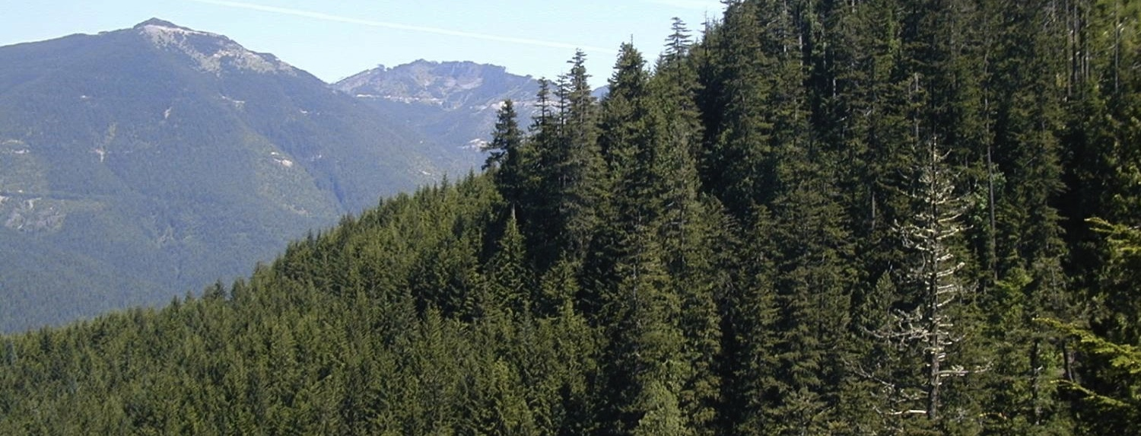
Our Vision
FSC® Canada
The world’s forests meet the social, ecological, and economic rights and needs of the present generation without compromising those of future generations.
Rights of Aboriginal Peoples and local communities are respected.
Wildlife habitat & species protected ….
Economically viable forest management

Slide 4






FSC® Canada
What is FSC?
Responsible
Forest Management
Certification tracks products from the forest to the market
In Canada, 80% of Indigenous communities are forest-based
Healthy Forests
& Communities
Supply Chain
Tracking
Product Label
* 3rd party, voluntary, market-based, non-governmental

Slide 5

FSC CA Board (& Standard Committee)
Standard Development Group
Technical Expert Panels
FSC Canada Standards Revision Process
Principles & Criteria v4
P&C v5
and
International Generic Indicators
(IGIs)
In Canada
4 regional standards
One National FM Standard
[mid 2016]

Slide 6
Aboriginal Rights and FPIC
Technical Expert Panel
D1 - TEP discussion & recommended approach
D1.1 – SDG & SC review and comments provided to TEP
D2 – TEP discussion and review
WEBINAR - stakeholder review and discussion
POST WEBINAR - Comments accepted to November 21.
Vivian Peachey(Lead), FSC Canada
Dr. Peggy Smith, Lakehead University
Sandra Cardinal, ALPAC
Dr Sara Teitelbaum, University of Montreal
Michel Mongeon, Tech for, géographe
Geneviève Labrecque, Tembec

Slide 7
“A forest company has a limited amount of time and resources – like a bucket.
Depending on the type and number of P&Cs and accompanying IGIs that are placed inside the bucket, some of the requirements may, or may not overflow. FSC needs to focus on the most meaningful actions that will improve and support good forestry, so in turn the company can focus on meaningful action.” Canadian stakeholder
Boreal Standard 203
Maritime Standard 153
US Standard 181-191
D1 IGIs 340
FSC CA National Standard
?
BC Standard 202
GLSL Standard 138 (public) 131 (private)
UK Standard
84
D3 IGIs
200
International Generic Indicators – Final Draft
P1 Compliance with Laws [24 indicators]
P2 Workers’ Rights and Employment Conditions [24 indicators]
P3 Indigenous Peoples’ Rights [15 indicators]
P4 Community Relations [19 indicators]
P5 Benefits from the Forest [14 indicators]
P6 Environmental Values and Impacts [34 indicators]
P7 Management Planning [12 indicators]
P8 Monitoring and Assessment [9 indicators]
P9 High Conservation Values [14 indicators]
P10 Implementation of Management Activities [33 indicators]

Slide 8
In Canada, who is the intended audience?
of the IGIs?
  Most cases, the medium to large
of revised national standard?
  High risk, large tenures
  SLIMF standard <1000 ha
  Community and county forests (1,000 to 50,000 ha)

Slide 9


A Forest Management Standard is not:
A conceptual, philosophical, absolute or definitive document that describes all possible attributes of good forestry.
Certification needs to work within the authority of the organization. It needs to be practical and achievable.

Slide 10
SMART Indicators
Specific: Each indicator should refer to a single aspect of performance to be evaluated. An indicator including more than one aspect to be evaluated shall list these aspects separately as sub-divisions of the indicator (60-002).
Measurable: Indicators shall specify outcomes or levels (i.e. thresholds) of performance that are measurable during an evaluation at a reasonable cost. The level of performance required to comply with the indicators should be clear to the reader (60-002). In general, specific outcomes will be favored over arbitrary thresholds.
Achievable: Indicators shall not be defined in terms of design or descriptive characteristics, and shall not favour a particular technology or patented item (60-002).
Relevant: Indicators shall only include elements that contribute to the achievement of the objective of the applicable FSC Criterion (60-002).
Tangible: Indicators shall be written using a clear and consistent vocabulary, free from subjective elements. The use of such phrases as “ordinarily”, “substantial”, “proactive”, “appropriate to”, “minimize”, “wherever possible”, “thorough” or “best available” should be avoided (60-002).

Slide 11
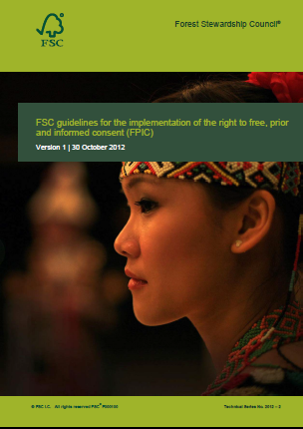
How does FSC address Aboriginal Rights?
Governance structures
Permanent Indigenous Peoples Committee (PIPC)
Standards, policies and certification requirements
… Principle 3
… as defined in Principle 3,
including reference to ILO 169, UNDRIP- FPIC
FPIC Guidance
FSC is recognized as currently having the most to offer Indigenous communities

Slide 12
For FSC IC, a general description of FPIC is:
“The right to participate in decision making and to give, modify, withhold or withdraw consent to an activity affecting the holder of this right. Consent must be freely given, obtained prior to implementation of such activities and be founded upon an understanding of the full range of issues implicated by the activity or decision in question; hence the formulation: free, prior and informed consent”(van der Vlist and Richert, 2012, p. 11).

Slide 13
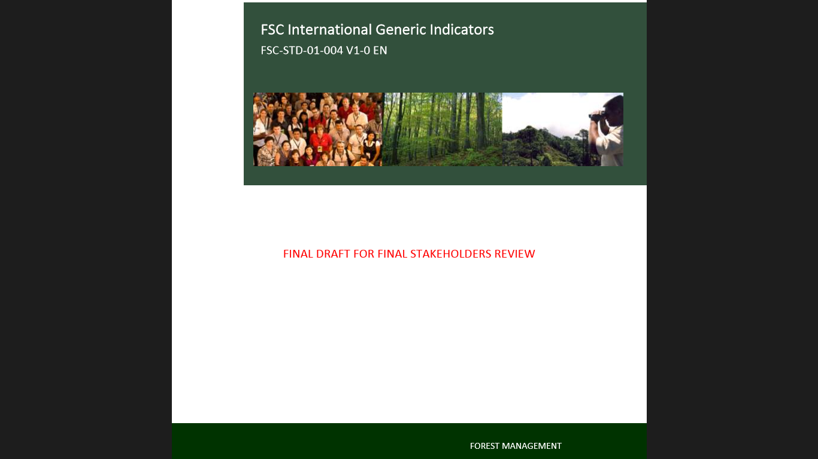
How does FSC address Aboriginal Rights?
Principle 3
Criteria and indicators
FSC Guidance on Applying FPIC
Step 1 – Identify rights holders and their representative institutions
Step 2 – Prepare for further engagement with identified communities
Step 3 – Map rights, resources, lands and territories and assess impacts
Step 4 – Inform affected indigenous rights holders
Step 5 – Negotiate and let community decide on negotiated FPIC proposal
Step 6 – Formalize, verify, implement and monitor the consent agreement
FSC Canada National Standard

Slide 14
Principle 3: Indigenous Peoples Rights
Identification of indigenous peoples affected by management activities
FREE
PRIOR
INFORMED
Support building of capacity of Indigenous Peoples to participate
CONSENT sought on management activities
Binding agreements
Rights respected
Sites of special cultural, ecological, economic, religious or spiritual significance identified and protected
Traditional knowledge* and intellectual property* is protected, acknowledged and compensated (FPIC)
…………….. all through culturally appropriate engagement

Slide 15
Studies show that…
P3 & Aboriginal relations received 2nd most number of conditions (Masters et al., ‘10)
FSC led to formal agreements, & these were considered beneficial (capacity, outputs, relationship building) (Teitelbaum, ’09)
Agreements are instrumental, but not straightforward due to shared jurisdiction between government and companies (Teitelbaum, ‘13)
Positive examples of collaboration (e.g. treaties, agreements, MOUs) (Wyatt et al, ‘13)
FSC process is good at identifying problematic issues that support progress (Teitelbaum, ’09)
High variability; system needs greater consistency in determining compliance
Notes:
Lastly, it is also important to consider how the Canadian government considers FPIC. In Canadian national law, the Updated Guidelines for Federal Officials to Fulfill the Duty to Consult mentions free, prior and informed consent but merely to highlight the federal government’s concern around FPIC as a veto power. (Notions of FPIC as not a veto power are also mentioned in the FSC IC Guidelines for FPIC.) This is repeatedly addressed on various governmental websites (e.g. Permanent Mission of Canada to the United Nations: CanadaInternational.gc.ca and Aboriginal Affairs and Northern Development Canada) and also in court cases that relate to FPIC. For instance:
“This process does not give Aboriginal groups a veto over what can be done with land pending final proof of the claim. The Aboriginal “consent” spoken of in Delgamuukw is appropriate only in cases of established rights, and then by no means in every case. Rather, what is required is a process of balancing interests, of give and take” (Haida Nation v. British Columbia (Minister of Forests), 2004).
Therefore, how consent is viewed within a governmental context, I would argue, has the potential to limit the objectives of FPIC within FSC certification. This bears to question FSC Canada’s sphere of influence in driving the implementation of FPIC. Can FPIC be implemented without government involvement? In the excerpt above it is stipulated that consent is appropriate in cases of established rights, but where rights have been extinguished what becomes of consent then? Fortunately, FSC Guideline requirements recognize customary rights and have a very specific definition of Indigenous peoples that is geared toward self-identification. This highlights potential areas of contention of disagreement between interpretations surrounding when it is “appropriate” to seek Aboriginal consent and what roles the Canadian government, FSC Canada, applicants, and Indigenous peoples play to ensure the success of FPIC, not only for forest certification, but to ensure self-determination for each Nation.

Slide 16
Panel
Aboriginal Rights - Technical Expert Panel Discussion
  Identification of rights
  Peggy Smith, Lakehead University
  Russ Diabo
  Capacity building
  Michel Mongeon
  Kevin Gilles
  Free, prior and informed consent
  Sandra Cardinal, ALPAC
  Sara Teitelbaum

Slide 17
Identification of rights
ADAPT - Draft 3 IGIs
3.1.2 Through culturally appropriate* engagement* with the indigenous peoples* identified in 3.1.1, the following are documented and/or mapped:
Their legal* and customary rights* of tenure*;
Their legal* and customary* access to, and use rights*, of the forest* resources and ecosystem services*;
Their legal* and customary rights* and obligations that apply within the forest management unit;
The evidence supporting these rights and obligations responsibilities;
Areas where rights are contested between indigenous peoples*, governments and/or others;
Summary of the means by which the legal* and customary rights* and contested rights, are addressed by The Organization*;
The expressed aspirations and goals of indigenous peoples* related to management activities.

Slide 18
Building capacity to engage
ADD from National Boreal Standard
3.1.3 The applicant participates in and/or supports the efforts of the affected Indigenous communities to develop the financial, technical and logistical capacity to enable them to participate in all aspects of forest management and development. This could include (but is not restricted to) activities ranging from planning and decision-making to the establishment of businesses or the pursuit of employment related to forest management.
Verifier:
The Indigenous communities are satisfied that the applicant is making reasonable effort to support or assist them to achieve their interests in forest development.
Intent, 3.1.3
The applicant’s support of capacity building should encourage an increased role for Indigenous communities in forest management. The applicant encourages an environment leading to increasing roles and responsibilities for Indigenous communities leading to joint management, where that is the desired objective.

Slide 19
Free, prior and informed consent
ADAPT from Draft 3 IGIs
3.2.4 Free, prior and informed consent* is granted by indigenous peoples* prior to management activities that affect their identified rights through a process that includes:
Ensuring indigenous peoples* know their rights and obligations regarding the resource;
Informing the indigenous peoples* of the value, in economic, social and environmental terms, of the resource over which their legal or rights may be impacted by management activities the are considering delegation of control;
Informing the indigenous peoples* of their right to withhold consent to the proposed management activities to the extent necessary to protect rights, resources, lands and territories*; and
Informing the indigenous peoples* of the current and future planned forest* management activities.

Slide 20
Closing
Each Nation has their own interests and priorities, sometimes forestry and sometimes with other pressing matters;
There is high variability (varying circumstances, community and company interests, requirements and capacities);
Having an agreement and being in agreement are different;
Consent within agreements cannot be formulaic; it will vary from Nation to Nation and there are different levels & types of consent

Slide 21
Closing
FPIC as an ongoing and flexible process
Clarity between parties on what FPIC means
A focus on relationship-building
Sufficient time and resources
Building an inclusive process
Rigorous auditing
Unpacking the issue of consent

Slide 22

FSC® Canada
Thank you.
Vivian Peachey
Director of Standards and Policy
647-528-0140
v.peachey@ca.fsc.org

